Slide 1


Slide 2

School of Computing Science and Engineering
Course Code: BCS01T1001 Course Name: Data Analytics (Excel and Tableau)
Unit 3
Exploring Analysis Tool pack
Faculty Name: Dr.L.Godlin Atlas Program Name: B.Tech

Slide 3
Objective
Histogram
Descriptive Statistics
Moving Average
Exponential
Correlation
Regression

Slide 4
Introduction
Moving Average
In statistics, a moving average (rolling average or running average) is a calculation to analyze data points by creating a series of averages of different subsets of the full data set.
It is also called a moving mean (MM) or rolling mean and is a type of finite impulse response filter.

Slide 5
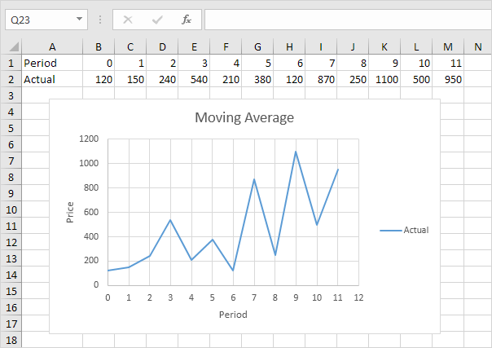
Moving Average
This example teaches you how to calculate the moving average of a time series in Excel. A moving average is used to smooth out irregularities (peaks and valleys) to easily recognize trends.
1. First, let's take a look at our time series.

Slide 6
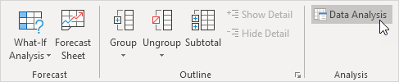
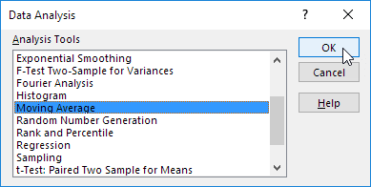
Moving Average
2. On the Data tab, in the Analysis group, click Data Analysis.
3. Select Moving Average and click OK.

Slide 7
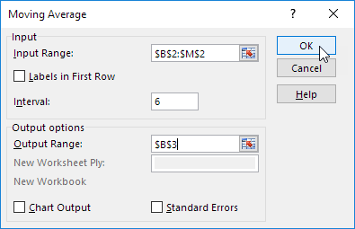
Moving Average
4. Click in the Input Range box and select the range B2:M2.
5. Click in the Interval box and type 6.
6. Click in the Output Range box and select cell B3.
7. Click OK.

Slide 8
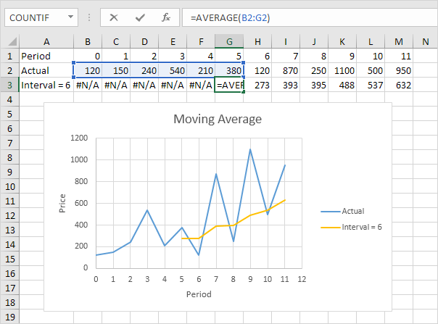
Moving Average
8. Plot a graph of these values.
Explanation: because we set the interval to 6, the moving average is the average of the previous 5 data points and the current data point. As a result, peaks and valleys are smoothed out. The graph shows an increasing trend. Excel cannot calculate the moving average for the first 5 data points because there are not enough previous data points.

Slide 9
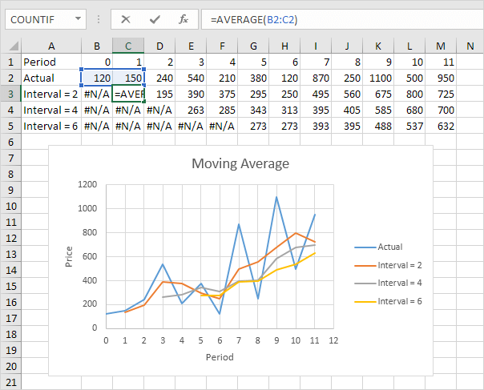
Moving Average
9. Repeat steps 2 to 8 for interval = 2 and interval = 4.
Conclusion: The larger the interval, the more the peaks and valleys are smoothed out. The smaller the interval, the closer the moving averages are to the actual data points.

Slide 10
References
Books:
1. Microsoft Excel 2013 Step by Step by Curtis D. Frye; Microsoft Press 2013.
2. Learning Tableau by Joshua N. Milligan,ISBN 139781784391164, PACKT Books - Packt Publishing
Reference Books:
Excel: Quick Start Guide from Beginner to Expert, by William Fischer
Web:
1. https://www.excel-easy.com/examples/correlation.html

Slide 11
For Queries Contact
Dr.L.Godlin Atlas
Email Id: godlin.atlas@galgotiasuniversity.edu.in
Whatsapp: 9080806220

Slide 12


